Slide 1
IBM PROJECT
Mitigating Keylogger Threats: A Predictive Approach
Presented By:
PRABHA K,
731321104022,
J.K.K. Nataraja College of Engineering and Technology, BE.CSE.

Slide 2
OUTLINE
Problem Statement
Proposed System/Solution
System Development Approach
Algorithm & Deployment
Result
Conclusion
Future Scope
References

Slide 3
Problem Statement
In today's digital age, where cybersecurity threats loom large, one of the significant concerns is the proliferation of keyloggers, stealthy software tools designed to monitor and record keystrokes on a user's computer without their knowledge. Keyloggers pose a severe threat to individuals and organizations as they can capture sensitive information such as passwords, credit card details, and other personal data, leading to identity theft, financial loss, and privacy breaches.

Slide 4
Proposed System
The proposed system aims to address the challenge of predicting the required bike count at each hour to ensure a stable supply of rental bikes. This involves leveraging data analytics and machine learning techniques to forecast demand patterns accurately. The solution will consist of the following components:
Data Collection:
Gather keystroke patterns, system events, and user behaviour data.
Utilize real-time monitoring to capture anomalies and suspicious activities.
Data Preprocessing:
Clean and preprocess the collected data to handle noise and inconsistencies.
Extract relevant features indicating potential keylogger activity.
Machine Learning Algorithm:
Implement anomaly detection or classification models.
Train algorithms using labelled data to distinguish normal from malicious keystroke activity.
Deployment:
Develop a lightweight agent/application for real-time monitoring.
Deploy on endpoints and network gateways for comprehensive protection.
Evaluation:
Assess the system performance using metrics like accuracy, precision, recall, and false positive rate.
Conduct extensive testing to ensure effectiveness in detecting and preventing keylogger attacks.

Slide 5
System Approach
System Requirements:
Real-time monitoring capabilities to detect keylogger activity.
Compatibility with various operating systems and software environments.
Low resource consumption to minimize impact on system performance.
Library Required to Build the Model:
Python libraries for data preprocessing, machine learning, and real-time monitoring:
`scikit-learn` for implementing machine learning algorithms.
`pandas` and `numpy` for data manipulation and preprocessing.
`keyboard` or `pynput` for capturing keystrokes in real-time.
`matplotlib` or `seaborn` for data visualization and analysis.

Slide 6
Algorithm & Deployment
Algorithm Selection:
We employ a machine learning-based anomaly detection algorithm, such as Isolation Forest.
Isolation Forest is well-suited for detecting anomalies in high-dimensional data, making it suitable for identifying irregular patterns indicative of keylogger activity.
It efficiently isolates anomalies by constructing random forests of decision trees, making it robust to noise and outliers.
Deployment:
The detection model is deployed as a lightweight agent on endpoints and network gateways.
Real-time monitoring ensures continuous surveillance for suspicious keystroke patterns.
Alerts are triggered upon detecting potential keylogger activity, enabling swift response and mitigation measures.

Slide 7
TYPES OF KEYLOGGERS
Software - Based Keyloggers
Hardware - Based Keyloggers
Kernal or Driver - Based Keyloggers
Remote Access Keyloggers
Wireless Keyloggers

Slide 8
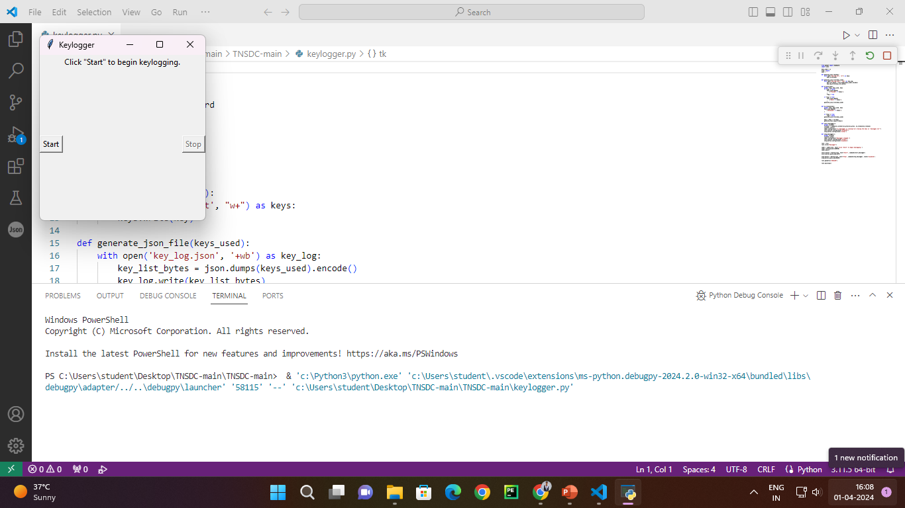
Result
OUTPUT IMAGE:

Slide 9
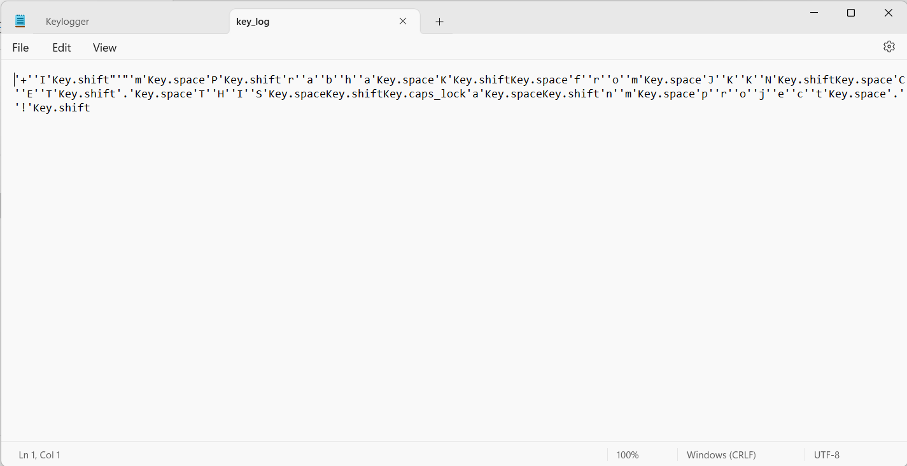
Output image:

Slide 10
Conclusion
Our predictive approach effectively mitigates keylogger threats by leveraging machine learning algorithms for anomaly detection. While challenges in real-time monitoring persist, continuous refinement and integration of advanced techniques promise enhanced security against evolving threats.

Slide 11
Security
Keyloggers compromise security by clandestinely capturing keystrokes, including sensitive information like passwords and financial details, without user consent. Detection and prevention methods involve robust antivirus software, vigilant monitoring for suspicious behavior, and implementing security measures to safeguard against unauthorized access and data exfiltration.

Slide 12
Future scope
The system can be enhanced by integrating additional data sources, optimizing algorithms, and expanding to cover multiple regions. Integration of emerging technologies like edge computing and advanced machine learning techniques promises further improvements in threat detection and prevention capabilities.

Slide 13
References
List and cite relevant sources, research papers, and articles that were instrumental in developing the proposed solution. This could include academic papers on bike demand prediction, machine learning algorithms, and best practices in data preprocessing and model evaluation.

Slide 14
THANK YOU

